Slide 1
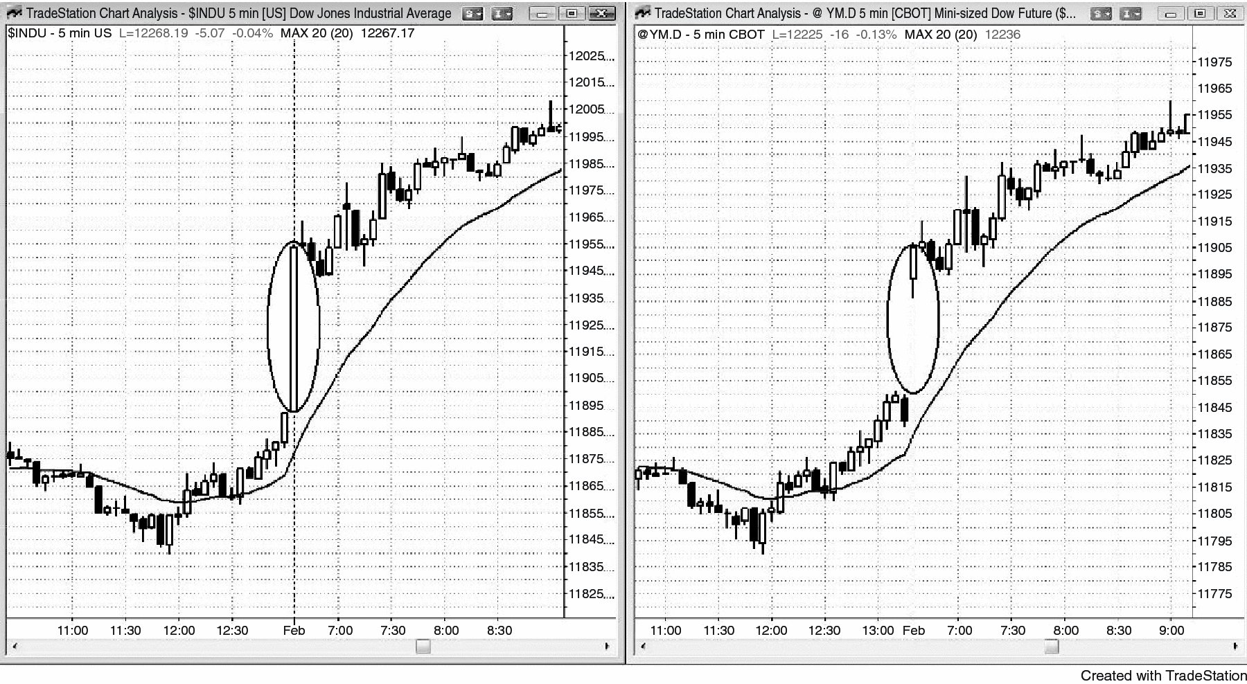
FIGURE 20.1 A Gap Is Just a Spike

Slide 2
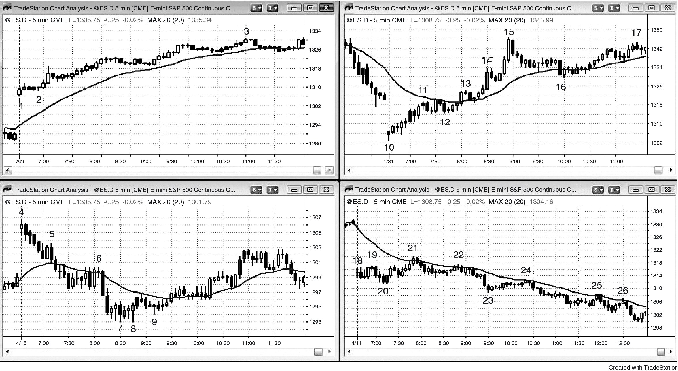
FIGURE 20.2 A Gap Can Lead to a Trend Up or Down

